Slide 1
Exceptions in Java
An exception is an object
  Signals the occurrence of unusual event during program execution
Throwing an exception
  Creating the exception object
Handling the exception
  Code that detects and deals with the exception

Slide 2
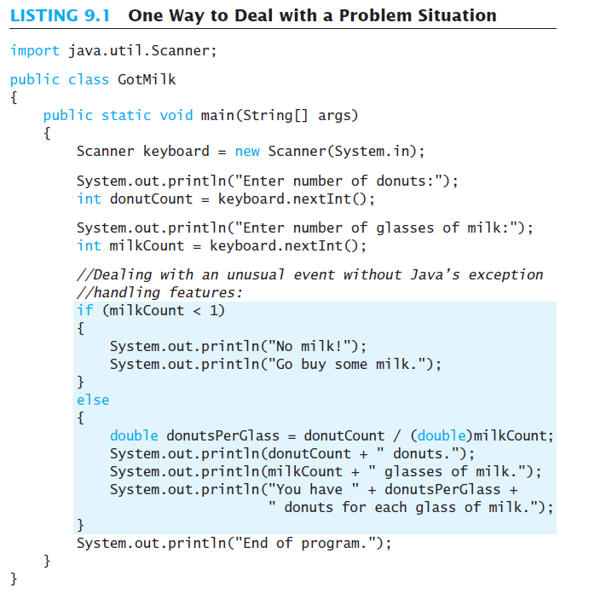
Exceptions in Java
Consider a program to assure us of a sufficient supply of milk

Slide 3
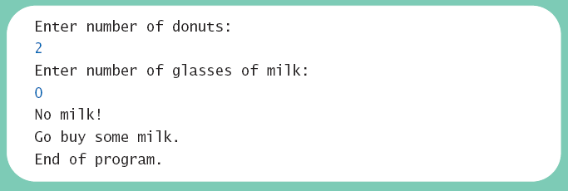
Exceptions in Java
Example of the output for class GotMilk in the previous slide
Sample
screen output

Slide 4
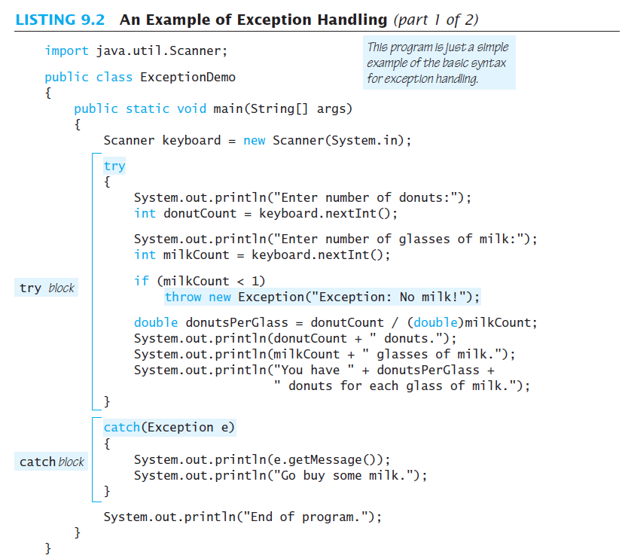
Exceptions in Java
Now we revise the program to use exception-handling
e called the catch-block parameter

Slide 5
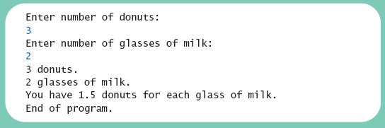
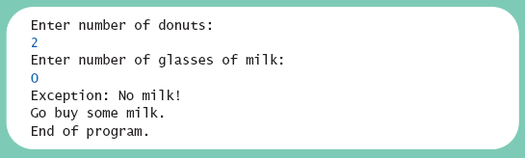
Exceptions in Java
View new version
class ExceptionDemo
Sample
screen output 1
Sample
screen output 2

Slide 6
Exceptions in Java
Note try block
  Contains code where something could possibly go wrong
  If it does go wrong, we throw an exception
Note catch block
  When exception thrown, catch block begins execution
  Similar to method with parameter
  Parameter is the thrown object

Slide 7
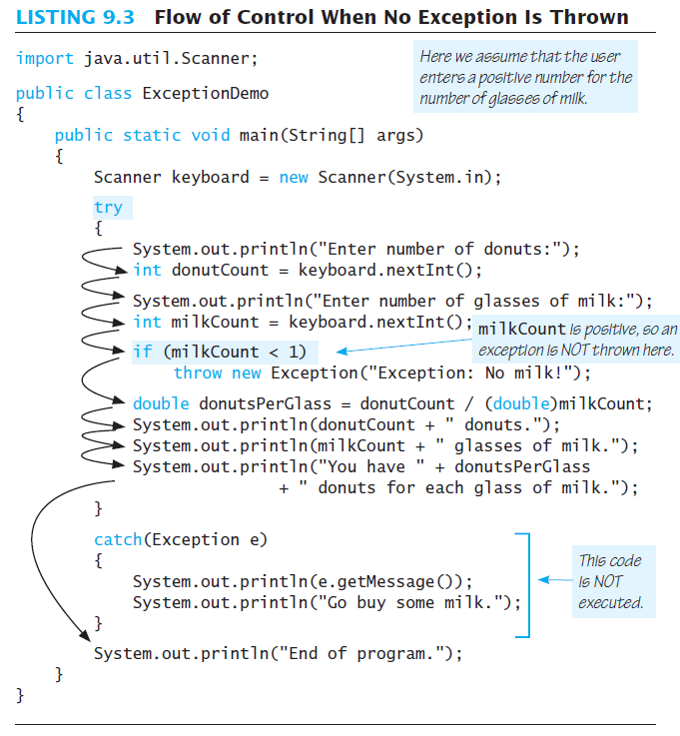
Exceptions in Java
Note flow of control when no exception is thrown
Sample
screen output with no exception

Slide 8
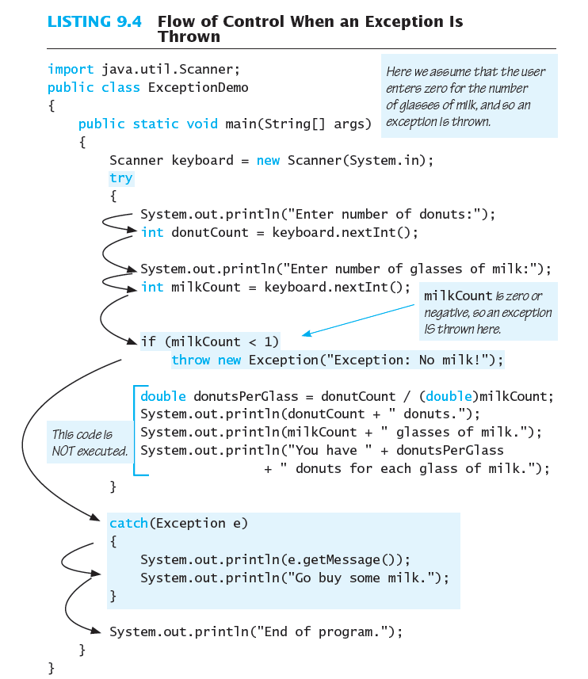
Exceptions in Java
Note flow of control when exception IS thrown
Exception exceptObject = new Exception
(“Exception: No milk!”);
throw exceptObject;
Sample
screen output when exception is thrown

Slide 9
Predefined Exception Classes
Java has predefined exception classes within Java Class Library
  Can place method invocation in try block
  Follow with catch block for this type of exception
Example classes
  BadStringOperationException
  ClassNotFoundException
  IOException
  NoSuchMethodException

Slide 10
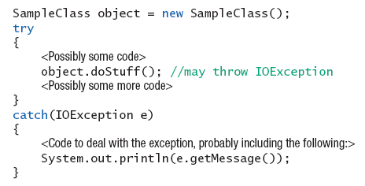
Predefined Exception Classes
Example code

Slide 11
Defining Your Own Exception Classes
Must be derived class of some predefined exception class
  Text uses classes derived from class Exception

Slide 12
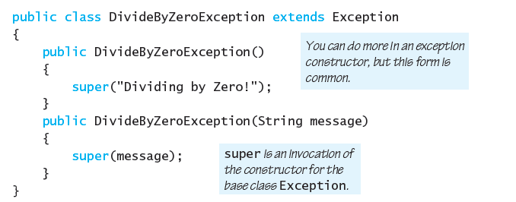
Defining Your Own Exception Classes
sample class, class DivideByZeroException
extends Exception

Slide 13
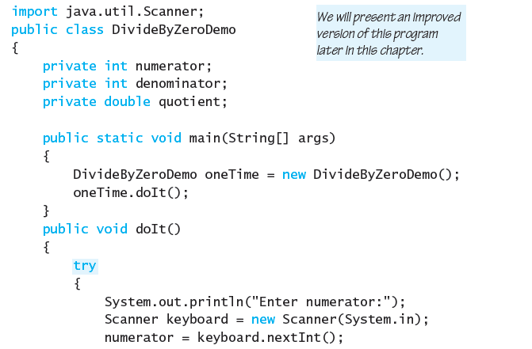
Defining Your Own Exception Classes

Slide 14
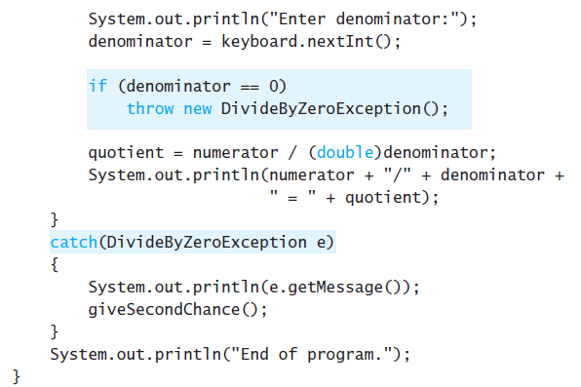
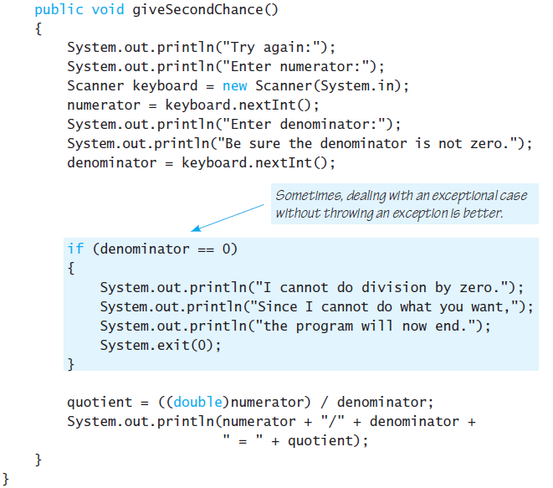
Defining Your Own Exception Classes

Slide 15
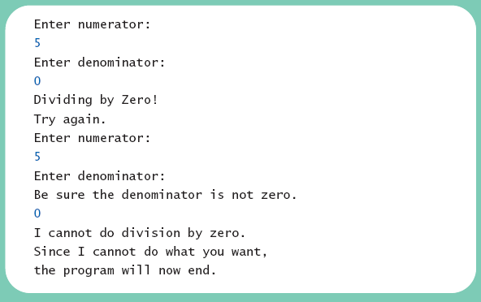
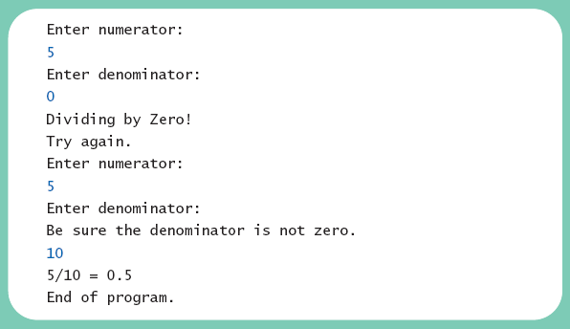
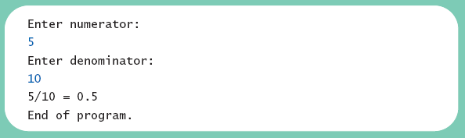
Defining Your Own Exception Classes
Different runs of the program
Sample
screen output 1
Sample
screen output 3
Sample
screen output 2

Slide 16
Defining Your Own Exception Classes
Note method getMessage defined in exception classes
  Returns string passed as argument to constructor
  If no actual parameter used, default message returned
The type of an object is the name of the exception class

Slide 17
Defining Your Own Exception Classes
Guidelines
Use the Exception as the base class
Define at least two constructors
  Default, no parameter
  With String parameter
Start constructor definition with call to constructor of base class, using super
Do not override inherited getMessage

Slide 18
Declaring Exceptions
Consider method where code throws exception
  May want to handle immediately
  May want to delay until something else is done
Method that does not catch an exception
  Notify programmers with throws clause
  Programmer then given responsibility to handle exception

Slide 19
Declaring Exceptions
Note syntax for throws clause
Note distinction
  Keyword throw used to throw exception
  Keyword throws used in method heading to declare an exception

Slide 20
Declaring Exceptions
If a method throws exception and exception not caught inside the method
  Method ends immediately after exception thrown
A throws clause in overriding method
  Can declare fewer exceptions than declared
  But not more

Slide 21
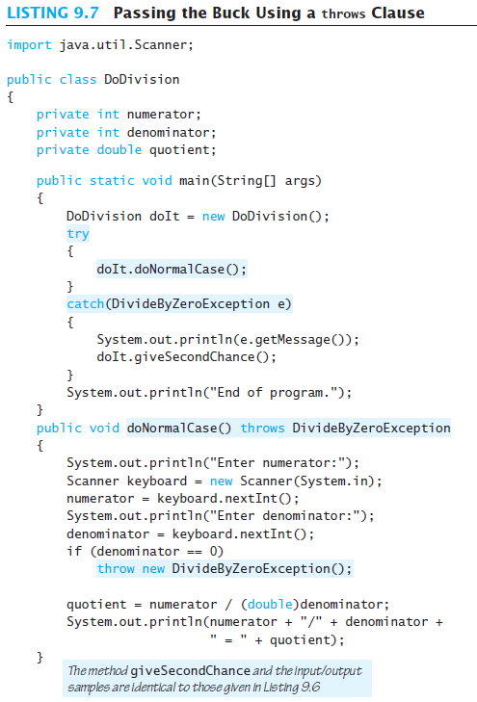
Declaring Exceptions

Slide 22
Kinds of Exceptions
In most cases, exception is caught …
  In a catch block … or
  Be declared in throws clause
But Java has exceptions you do not need to account for
Categories of exceptions
  Checked exceptions
  Unchecked exceptions

Slide 23
Kinds of Exceptions
Checked exception (e.g. ClassNotFoundException, IOException, and NoSuchMethodException)
  Must be caught in catch block
  Or declared in throws clause
Unchecked exception (e.g. ArrayIndexOutOfBoundsException or ArithmeticException)
  Also called run-time
  Need not be caught in catch block or declared in throws
  Exceptions that coding problems exist, should be fixed

Slide 24
Kinds of Exceptions
Examples why unchecked exceptions to are thrown
  Attempt to use array index out of bounds
  Division by zero
Uncaught runtime exception terminates program execution

Slide 25
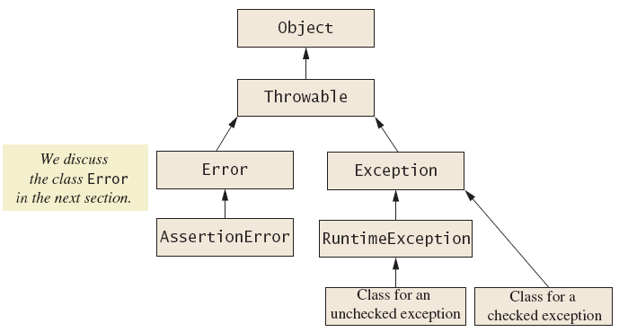
Kinds of Exceptions
Hierarchy of the predefined exception classes

Slide 26
Errors
An error is an object of class Error
  Similar to an unchecked exception
  Need not catch or declare in throws clause
  Object of class Error generated when abnormal conditions occur (e.g. OutOfMemoryError)
Errors are more or less beyond your control
  Require change of program to resolve

Slide 27
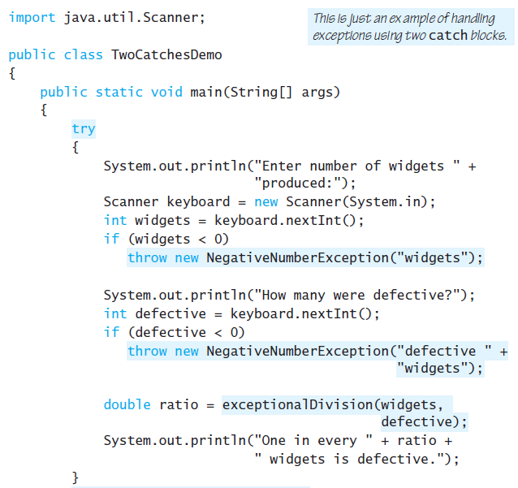
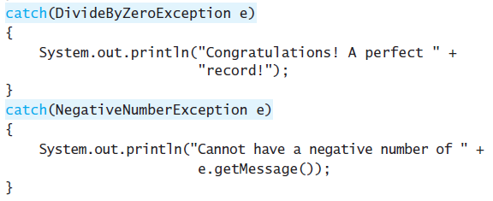
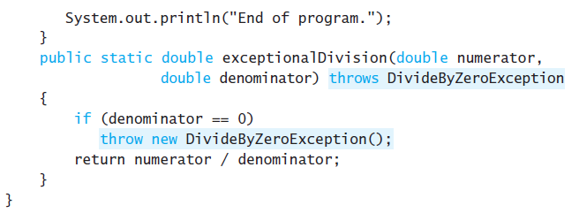
Multiple Throws and Catches
A try block can throw any number of exceptions of different types
Each catch block can catch exceptions of only one type
  Order of catch blocks matter

Slide 28
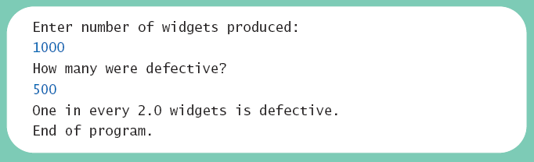
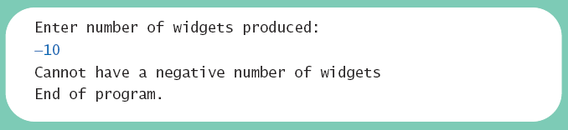
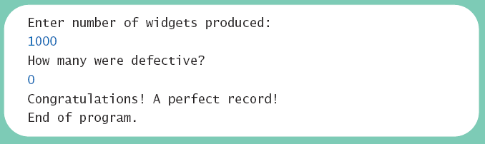
Multiple Throws and Catches
Note multiple sample runs
Sample
screen output 1
Sample
screen output 2
Sample
screen output 2

Slide 29
Multiple Throws and Catches
Exceptions can deal with invalid user input
To handle an exception thrown by a method
  It does not matter where in the method the throw occurs
Use of throw statement be should be reserved for cases where it is unavoidable
Nested try-catch blocks rarely useful

Slide 30
Multiple Throws and Catches
catch(Exception e)
{
}
catch(DivideByZeroException e)
{
}
catch(DivideByZeroException e)
{
}
catch(Exception e)
{
}

Slide 31
The finally Block
Possible to add a finally block after sequence of catch blocks
Code in finally block executed
  Whether or not execution thrown
  Whether or not required catch exists
  try
  {
  }
  catch blocks
  finally
  {
  }

Slide 32
Case Study
A Line-Oriented Calculator
  Should do addition, subtraction, division, multiplication
  Will use line input/output
User will enter
  Operation, space, number
  Calculator displays result

Slide 33
Case Study
Proposed initial methods
  Method to reset value of result to zero
  Method to evaluate result of one operation
  Method doCalculation to perform series of operations
  Accessor method getResult: returns value of instance variable result
  Mutator method setResults: sets value of instance variable result

Slide 34
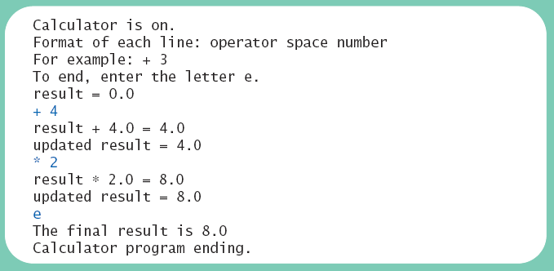
Case Study
Sample
screen output

Slide 35
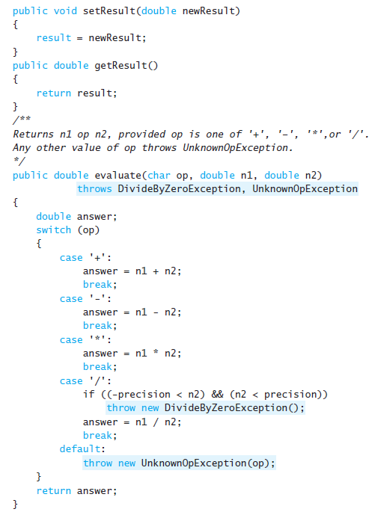
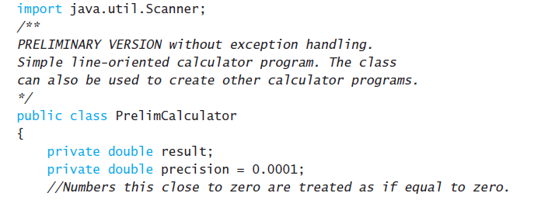
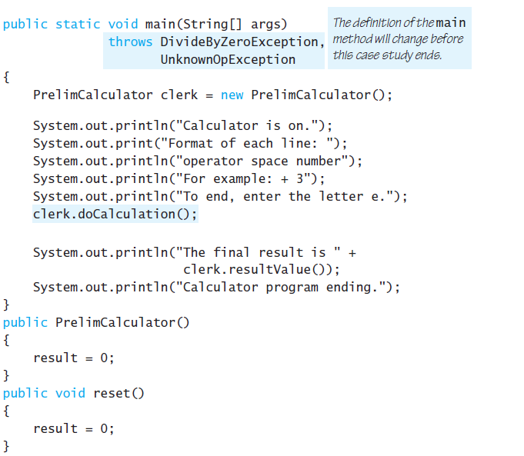

Slide 36
